Slide 1
C Chatbot
P9_2
Yi Xing, Elizabeth, Cheryl, Yu Fei, Declan and Ying Zhen

Slide 2
TABLE OF CONTENTS
01
02
03
04
Overview
Chatbot Functions
Knowledge Base
Demonstration

Slide 3
01
Overview

Slide 4
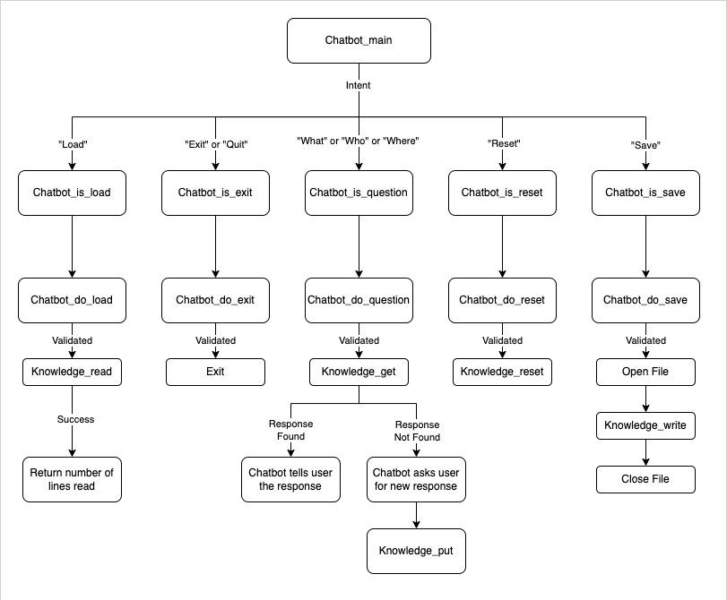
System Diagram

Slide 5
02
Chatbot Functions
Notes:
Next will be the chatbot functions

Slide 6
chatbot_main()
Notes:
First is chatbot_main

Slide 7
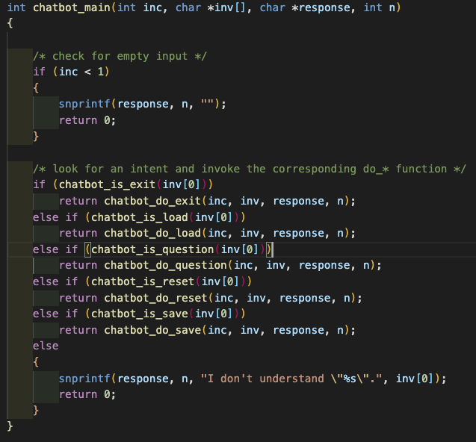
chatbot_main
Ignores empty input by user
Call the function for the corresponding intent
Inform user if intent is not recognised
Notes:
It will first checks for empty input by the user. If input is empty, it will ignore
and continues to prompt the user until the user inputs something to the chatbot.
The first word of the user's input indicates the intent. If the intent is valid, being
"exit", "load", "reset", "save", "what", "who", "where", it will call the function
based on the corresponding intent. If the intent is "load", it will call the
chatbot_do_load function.
If the intent example "how" is not recognised, chatbot will responds "I dont understand
"how".

Slide 8
chatbot_is_functions
Notes:
Next are the chatbot_is_functions.

Slide 9
chatbot_is_functions
int chatbot_is_exit(const char *intent)
{
return compare_token(intent, "exit") == 0 || compare_token(intent, "quit") == 0;
}
—----------—----------—----------—-----
int chatbot_is_question(const char *intent)
{
return compare_token(intent, "what") == 0 || compare_token(intent, "where") == 0 || compare_token(intent, "who") == 0;
}
—----------—----------—----------—-----
int chatbot_is_reset(const char *intent)
{
return compare_token(intent, "reset") == 0;
}
—----------—----------—----------—-----
Chatbot_is_exit check if intent is “exit” and “quit”
Chatbot_is_question check if intent is either “what”, “who” or “where”
Chatbot_is_reset check if intent is “reset”
Notes:
For chatbot_is_exit function, it check if intent is "exit" or "quit".
For chatbot_is_question function, it check if intent is either "what", "who" or "where".
For chatbot_is_reset, it check if intent is "reset".

Slide 10
chatbot_is_functions
int chatbot_is_load(const char *intent)
{
return compare_token(intent, "load") == 0;
}
—----------—----------—----------—-----
int chatbot_is_save(const char *intent)
{
return compare_token(intent, "save") == 0;
}
Chatbot_is_load check if intent is “load”
Chatbot_is_save check if intent is “save”
Notes:
For chatbot_is_load function, it check if intent is "load".
For chatbot_is_save function, it check if intent is "save".

Slide 11
chatbot_do_exit()
Notes:
Next is chatbot_do_exit function.

Slide 12
chatbot_do_exit
int chatbot_do_exit(int inc, char *inv[], char *response, int n)
{
snprintf(response, n, "Goodbye!");
return 1;
}
Return 1 to terminate the chatbot
Notes:
It will return 1 and terminate the chatbot.

Slide 13
chatbot_do_load()
Notes:
Next is the chatbot_do_load function.

Slide 14
chatbot_do_load
if ((!compare_str_end_with(file_name, ".ini")) && (inc >= 2))
{
snprintf(response, n, "I cannot read the file. Please upload a .ini file. e.g. 'sample.ini'");
}
.
.
.
else
{
data_loaded = knowledge_read(f);
fclose(f);
if (data_loaded == KB_NOMEM)
{
snprintf(response, n, "There is insufficient memory space. Please clear the knowledge in memory.");
}
else
{
snprintf(response, n, "I have read %d responses from %s", data_loaded, file_name);
}
}
}
Check for the length of question
Validate “.ini“ file type
Check if file entered exists
Pass file to knowledge_read and returns the number of data that has been successfully loaded.
Provide error handling for each scenario
Notes:
It will check for the length of the question. If the word only has "load" and does not
have the filename, the chatbot will prompt user to specify file to load.
if the user input contains the word "from", it will ignore this word and get the words
after as the filename.
If filename contains ".ini", it will check if file entered exists.
Else, it will prompt user to specify file of type .ini.
If the file exists, it will pass file to knowledge_read and returns the number of data
that has been successfully loaded.
Else, chatbot will prompt user to upload an existing .ini file.
If there is insufficient memory, chatbot will inform the user that there is insufficient
memory space.

Slide 15
chatbot_do_question()
Notes:
Next is chatbot_do_question function.

Slide 16
chatbot_do_question
if (article[0] != '\0')
{
prompt_user(response, MAX_RESPONSE, "I don't know. %s %s %s?", intent, article, entity);
}
else
{
prompt_user(response, MAX_RESPONSE, "I don't know. %s %s?", intent, entity);
}
—-------------------------------------------
put_result = knowledge_put(intent, entity, response);
if (put_result == KB_OK)
{
snprintf(response, n, "Thank you for the response.");
}
else if (put_result == KB_INVALID)
{
snprintf(response, n, "Unknown Question, please re-type.");
}
else if (put_result == KB_NOMEM)
{
snprintf(response, n, "Insufficient memory space. Please clear the knowledge in memory.");
}
Check for the length of question
Get the corresponding response to question
Get new response from user if question does not exist in memory
Provides error handling for each scenarios
Notes:
First, it will check for the length of the question. There are a few checking done:
If user input a single word and it is “what”, “where” or “who”, chatbot will prompt user to enter a full question.
If user input 2 words without an entity, it will check for article, example “is” or “are”.
If there is article, chatbot will prompt user to include a noun in the question. Else, it will save the intent and entity from user input.
If user input 3 or more words, it will check if the second word is a “is” or “are”. If it is true, it will iterate through the words after index 2 and append the words to entity. Else, it will iterate through the words after index 1 and append the words to entity.
Next, if the question entered by the user does not exist in memory, it will prompt user for new response and store into memory. Chatbot will displays “Thank you for the response”.
Lastly, is error handling.
If the new response entered by the user causes an error when updating into knowledge base, chatbot will display “Unknown question, please re-type”.
If knowledge_put operation was unsuccessful due to lack of memory, chatbot will displays “Insufficient memory space. Please clear the knowledge in memory”.
If knowledge_put operation was unsuccessful due to invalid intent, chatbot will displays “Invalid intent”.
Check the length of input and provide error handling for invalid questions
Get the corresponding response to the question
Write response to memory if question does not exist in memory
Checks for valid questions, if questions are invalid, chatbot will print error message and prompt
For error handling mention what error has been handled and how it is being handled.
for user response

Slide 17
chatbot_do_reset()
Notes:
Next is chatbot_do_reset function.

Slide 18
chatbot_do_reset
int chatbot_do_reset(int inc, char *inv[], char *response, int n)
{
knowledge_reset();
snprintf(response, n, "Chatbot reset.");
return 0;
}
Resets by calling knowledge_reset.
Chatbot responds with “Chatbot reset” and returns 0.
Notes:
It will resets by calling knowledge_reset. Chatbot will responds with “Chatbot reset” and returns 0.

Slide 19
chatbot_do_save()
Notes:
Next is chatbot_do_save function.

Slide 20
chatbot_do_save
for (int i = 0; i < inc; i++)
{
if (compare_str_end_with(inv[i], ".ini"))
{
strcpy(file_name, inv[i]);
file_name[strlen(file_name)] = '\0';
}
}
—--------------------------------------
if (f != NULL)
{
knowledge_write(f);
snprintf(response, n, "My knowledge has been saved to %s", file_name);
}
Extract the word that contains “.ini” from user input and save as the file name.
If successful, chatbot will execute knowledge_write and displays “My knowledge has been saved to <file name> successfully”.
Notes:
From the user input, it will extract the word that contains “.ini” and save as the file name.
If successful, chatbot will execute knowledge_write and displays “My knowledge has been saved to the specific file name successfully.

Slide 21
03
Knowledge Base

Slide 22
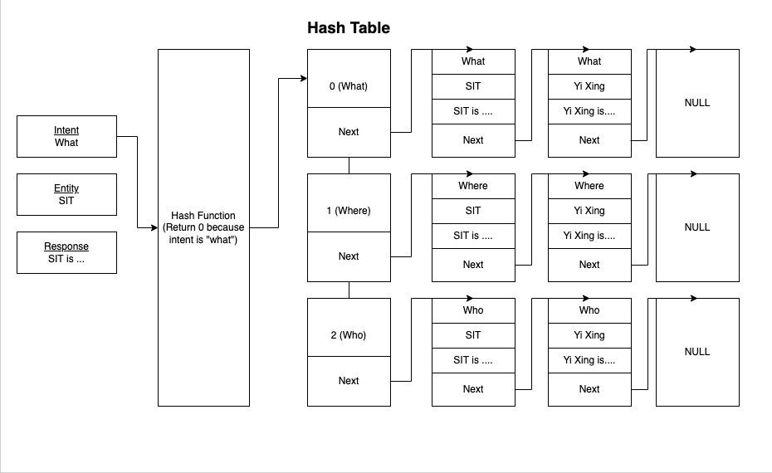
Hash Table

Slide 23
knowledge_get()

Slide 24
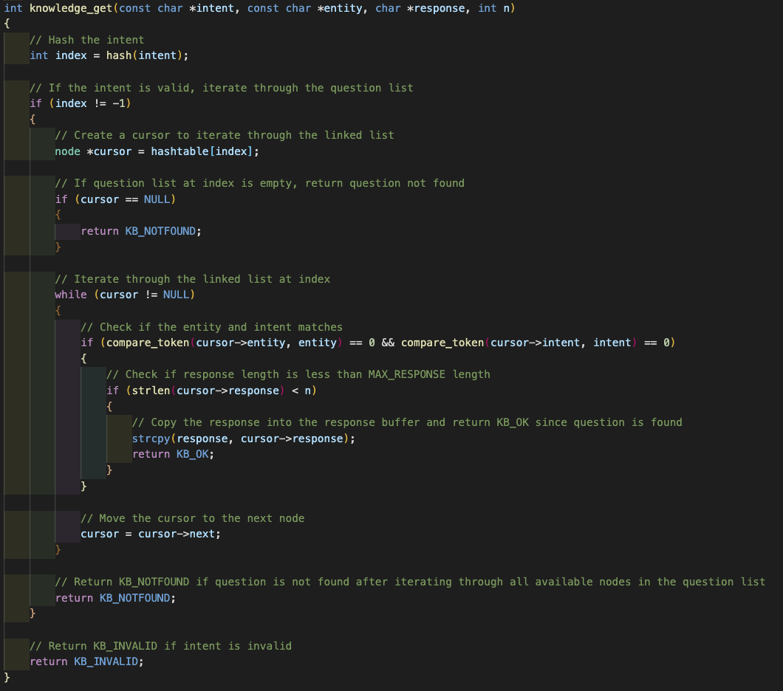
knowledge_get
Retrieves the response from the hash table based on the intent and entity
Returns response code
Notes:
While (cursor != NULL)

Slide 25
knowledge_put()

Slide 26
knowledge_put
if (hashtable[index] != NULL)
{
node *cursor = hashtable[index];
while (cursor != NULL)
{
if (compare_token(cursor->entity, entity) == 0 && compare_token(cursor->intent, intent) == 0)
{
strcpy(cursor->response, response);
return KB_OK;
}
cursor = cursor->next;
}
}
Traverses the linked list of the return index of the hash table and replace the response if there exists a matching intent and entity
Inserts a new node with the new response into the hash table
Returns response code

Slide 27
knowledge_put
if (hashtable[index] == NULL)
{
hashtable[index] = new_node;
return KB_OK;
}
else
{
new_node->next = hashtable[index];
hashtable[index] = new_node;
return KB_OK;
}
If question list is empty, add the new node to the hashtable
Else, add new node to start of the list

Slide 28
knowledge_read()

Slide 29
knowledge_read
fgets(buffer, buff_size, f);
if (buffer[0] == '[' && buffer[strlen(buffer - 2) == ']'])
{
strcpy(intent, strtok(buffer, delimiters));
intent[strlen(intent)] = '\0';
---------------------------------
do
{
valid_line = 0;
fgets(buffer, buff_size, f);
if (strchr(buffer, '=') != NULL)
{
valid_line = 1;
strcpy(entity, strtok(buffer, delimiters));
strcpy(response, strtok(NULL, delimiters));
entity[strlen(entity)] = '\0';
response[strlen(response)] = '\0';
int result = knowledge_put(intent, entity, response);
if (result == KB_OK)
{
success_read++;
}
else if (result == KB_NOMEM)
{
return KB_NOMEM;
}
}
} while (valid_line);
Read each line of the file and search for valid intents and the following entity-response pairs
Create new nodes and insert each entity and response pair into the right list
Return number of successful read into memory or response code
Returns response code

Slide 30
knowledge_reset()

Slide 31
knowledge_reset
void knowledge_reset()
{
for (int i = 0; i < MAX_HASHTABLE; i++)
{
if (hashtable[i] != NULL)
{
node *cursor = hashtable[i];
while (cursor != NULL)
{
node *next_node = cursor->next;
free(cursor);
cursor = next_node;
}
}
hashtable[i] = NULL;
}
}
Loops through the hashtable and frees all the nodes in each linked list
Hashtable is set to null after each linked list

Slide 32
knowledge_write()

Slide 33
knowledge_write
for (int i = 0; i < MAX_HASHTABLE; i++)
{
if (hashtable[i] != NULL)
{
node *cursor = hashtable[i];
if (i == 0)
{
fputs("[what]\n", f);
while (cursor != NULL)
{
strcpy(entity, cursor->entity);
strcpy(response, cursor->response);
strcat(entity, "=");
fputs(entity, f);
strcat(response, "\n");
fputs(response, f);
cursor = cursor->next;
}
fputc('\n', f);
}
Loop through the hash table array
Get the intents
Under each intent, write the entities and responses into the file line by line

Slide 34
04
Demonstration

Slide 35
Chatbot Demonstration

Slide 36
THANK YOU

